Slide 1


Cell images prediction
Angela Dunston
Capstone Project – Three
Springboard Data Science Career Track (2024)

Slide 2
The Problem
Infectious diseases such as malaria & dengue are caused by parasites like viruses
Body cells infected with parasites called – Parasitized cells
Cells that are not infected called – Uninfected cells
These cell images can be captured using microscopes
“ Can we predict the infected and uninfected cells from microscopic images?”

Slide 3
Goals of the project
Labelling the two classes of images
Extracting the features using image processing
Training the images on a suitable neural network model
Predicting the test images using the final model

Slide 4
Data wrangling
Setting the path for images
Labelling the images
Converting to series and DataFrame
Shuffling the
DataFrame

Slide 5
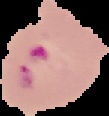

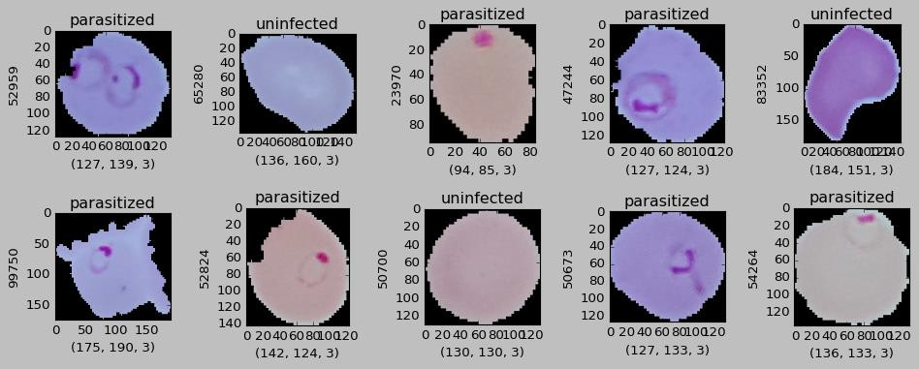
Exploratory Data Analysis
Image visualization
Images were labelled with two classes
Labelled images verified by matplotlib visualization
Parasitized cell
Uninfected cell
Image classes (binary):
0 – Parasitized
1 - Uninfected

Slide 6
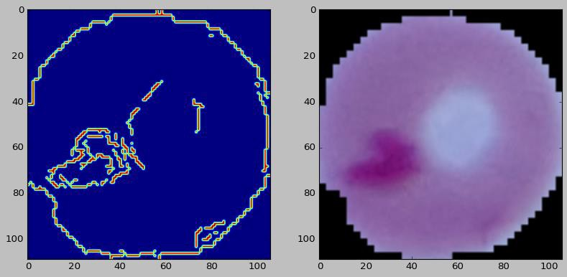
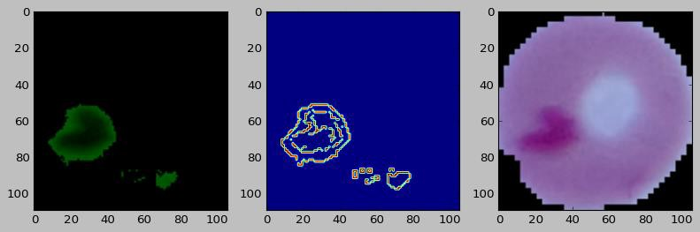
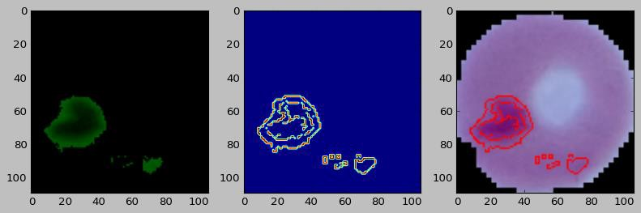
Extracting image features
Image edge detection
Image thresholding
Finding contours

Slide 7
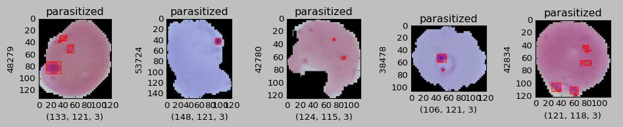
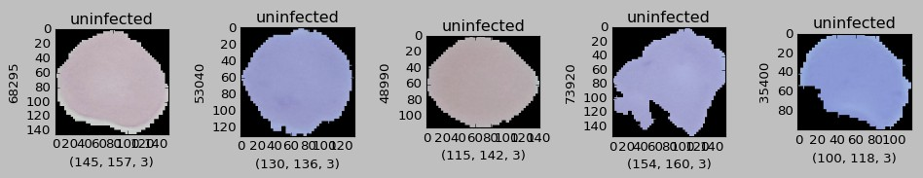
Applying features to the dataset
Parasitized set
Uninfected set

Slide 8
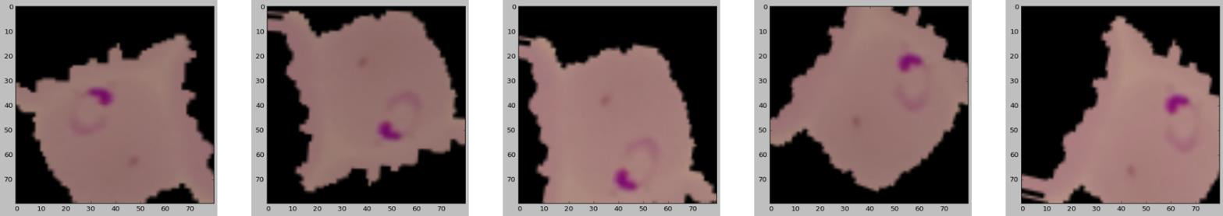
Preprocessing
Image augmentation
Generator Structure:
Keras Image Data Generator
Parameters used:
Rotation
Zoom
Brightness
Horizontal / vertical flips
Width / Height shift

Slide 9
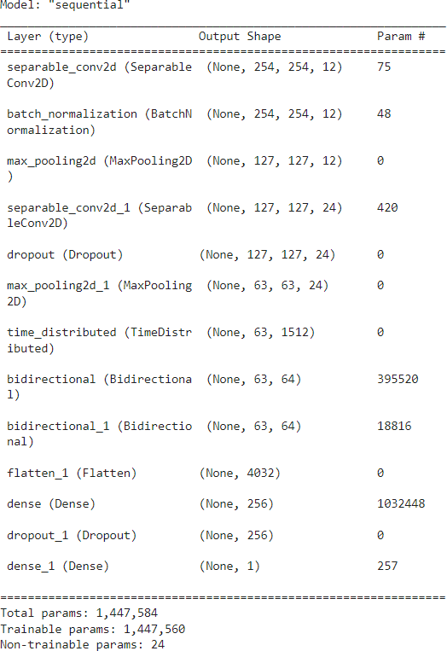
Modeling - Convolutional Neural Network (CNN)
Model Architecture
Model training
Performance metrics
Prediction

Slide 10
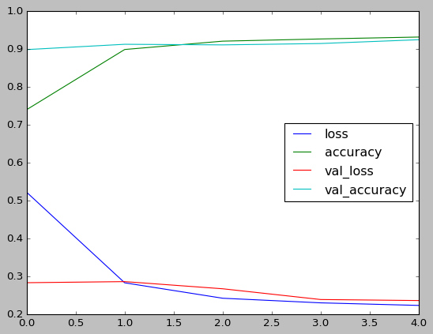
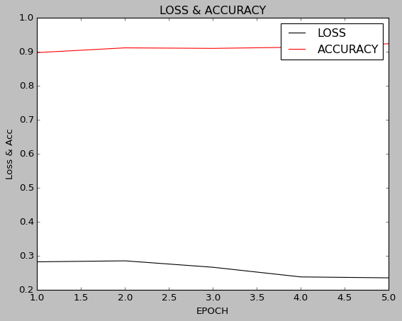
Model evaluation
Training vs validation
Loss & accuracy vs Epochs
 | Accuracy | Loss
Training image set | 0.93 | 0.22
Validation image set | 0.92 | 0.23
Test image set | 0.92 | 0.24

Slide 11
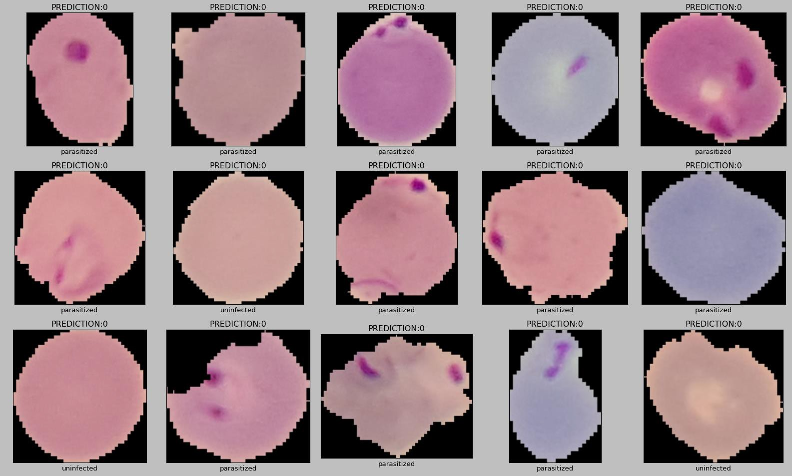
Prediction on test images

Slide 12
Summary
CNN model successfully classified the cell images classes
High accuracy (94%) and minimal loss (0.2) obtained
Very few images misclassified into other classes – can be rectified using larger sample size
Other models can be also tested in future for model comparison study.

